Slide 1

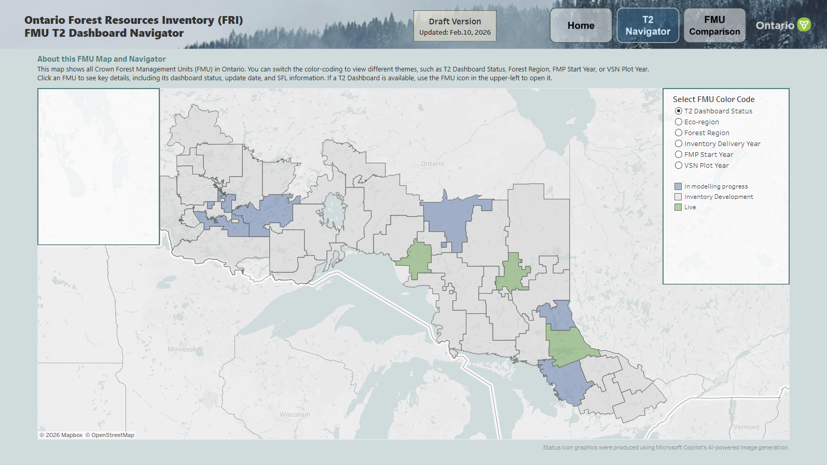
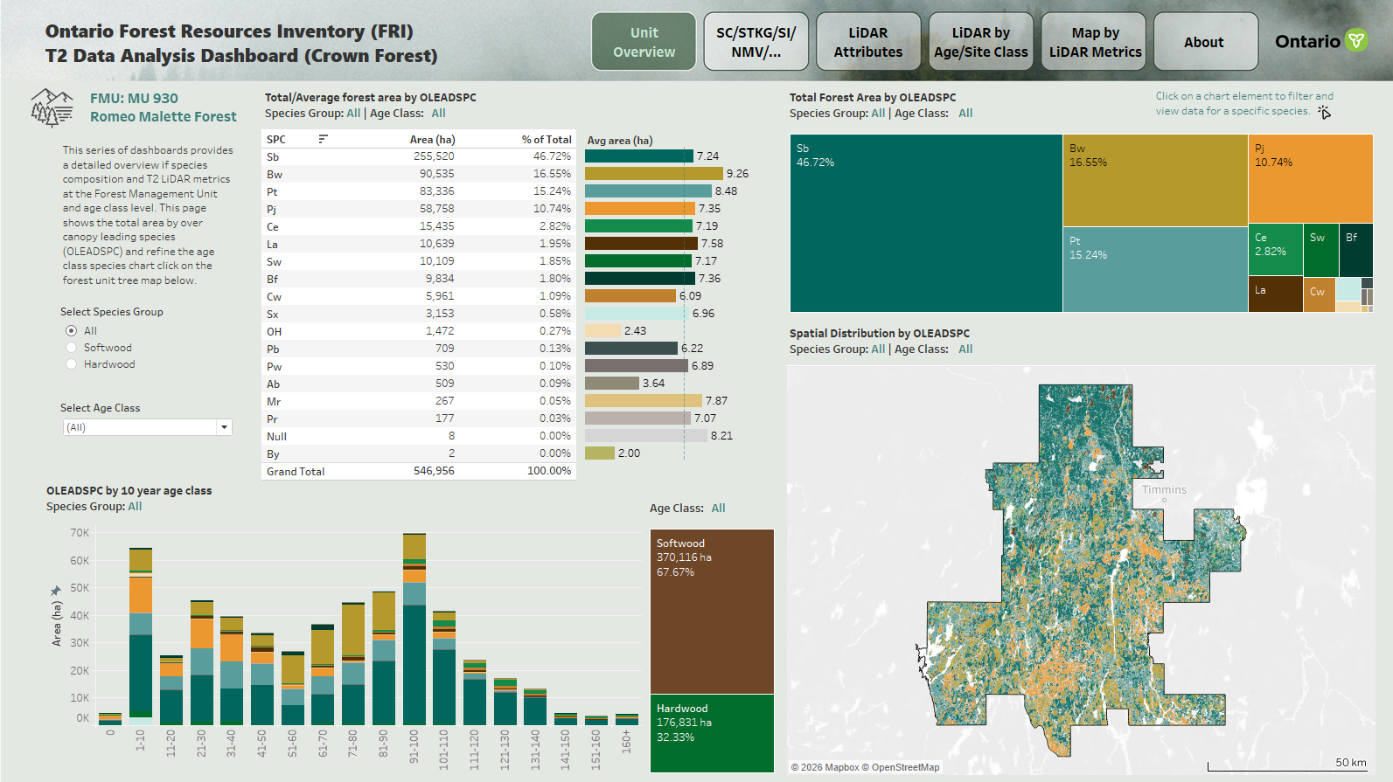
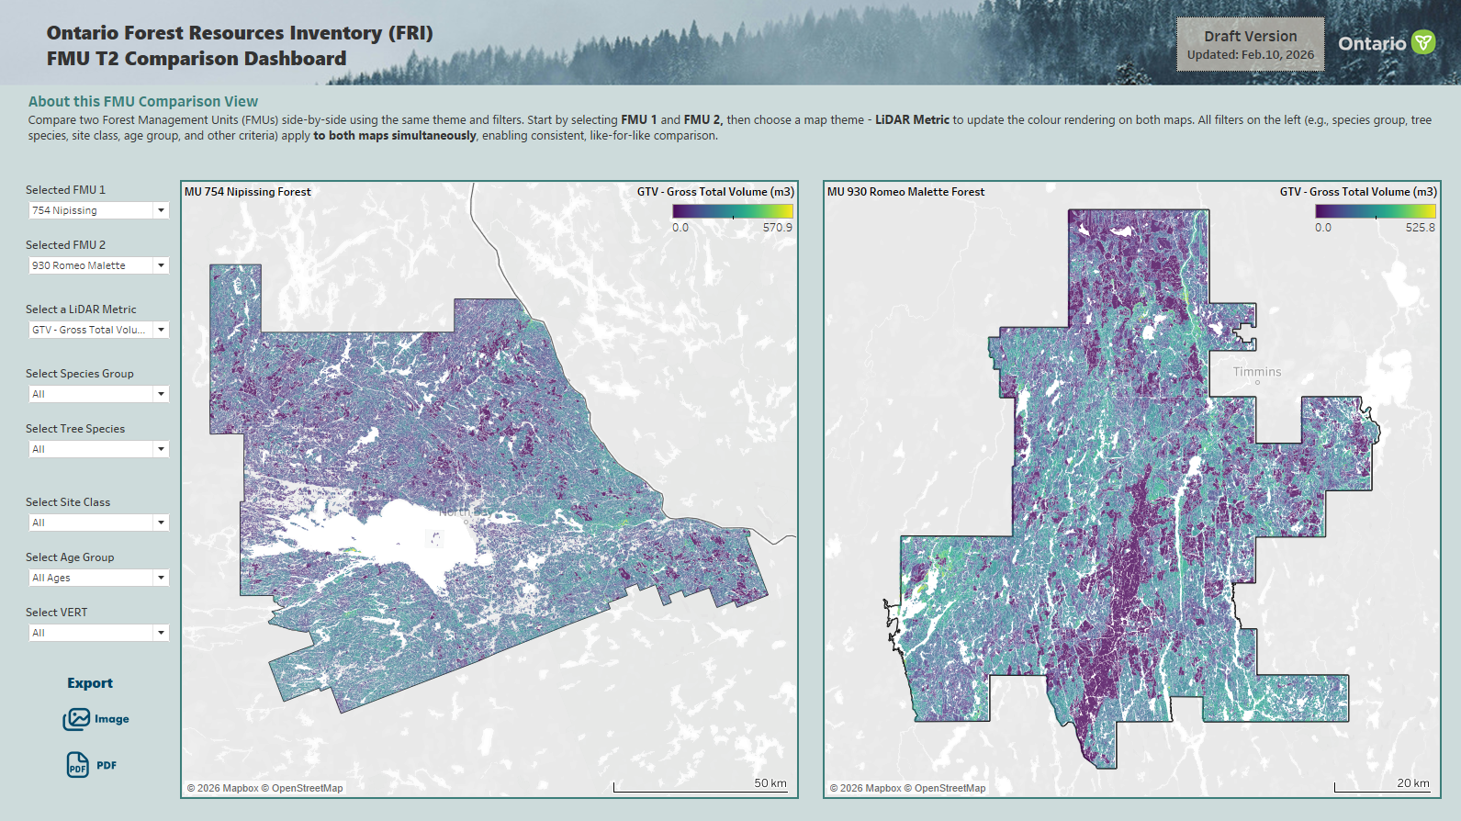
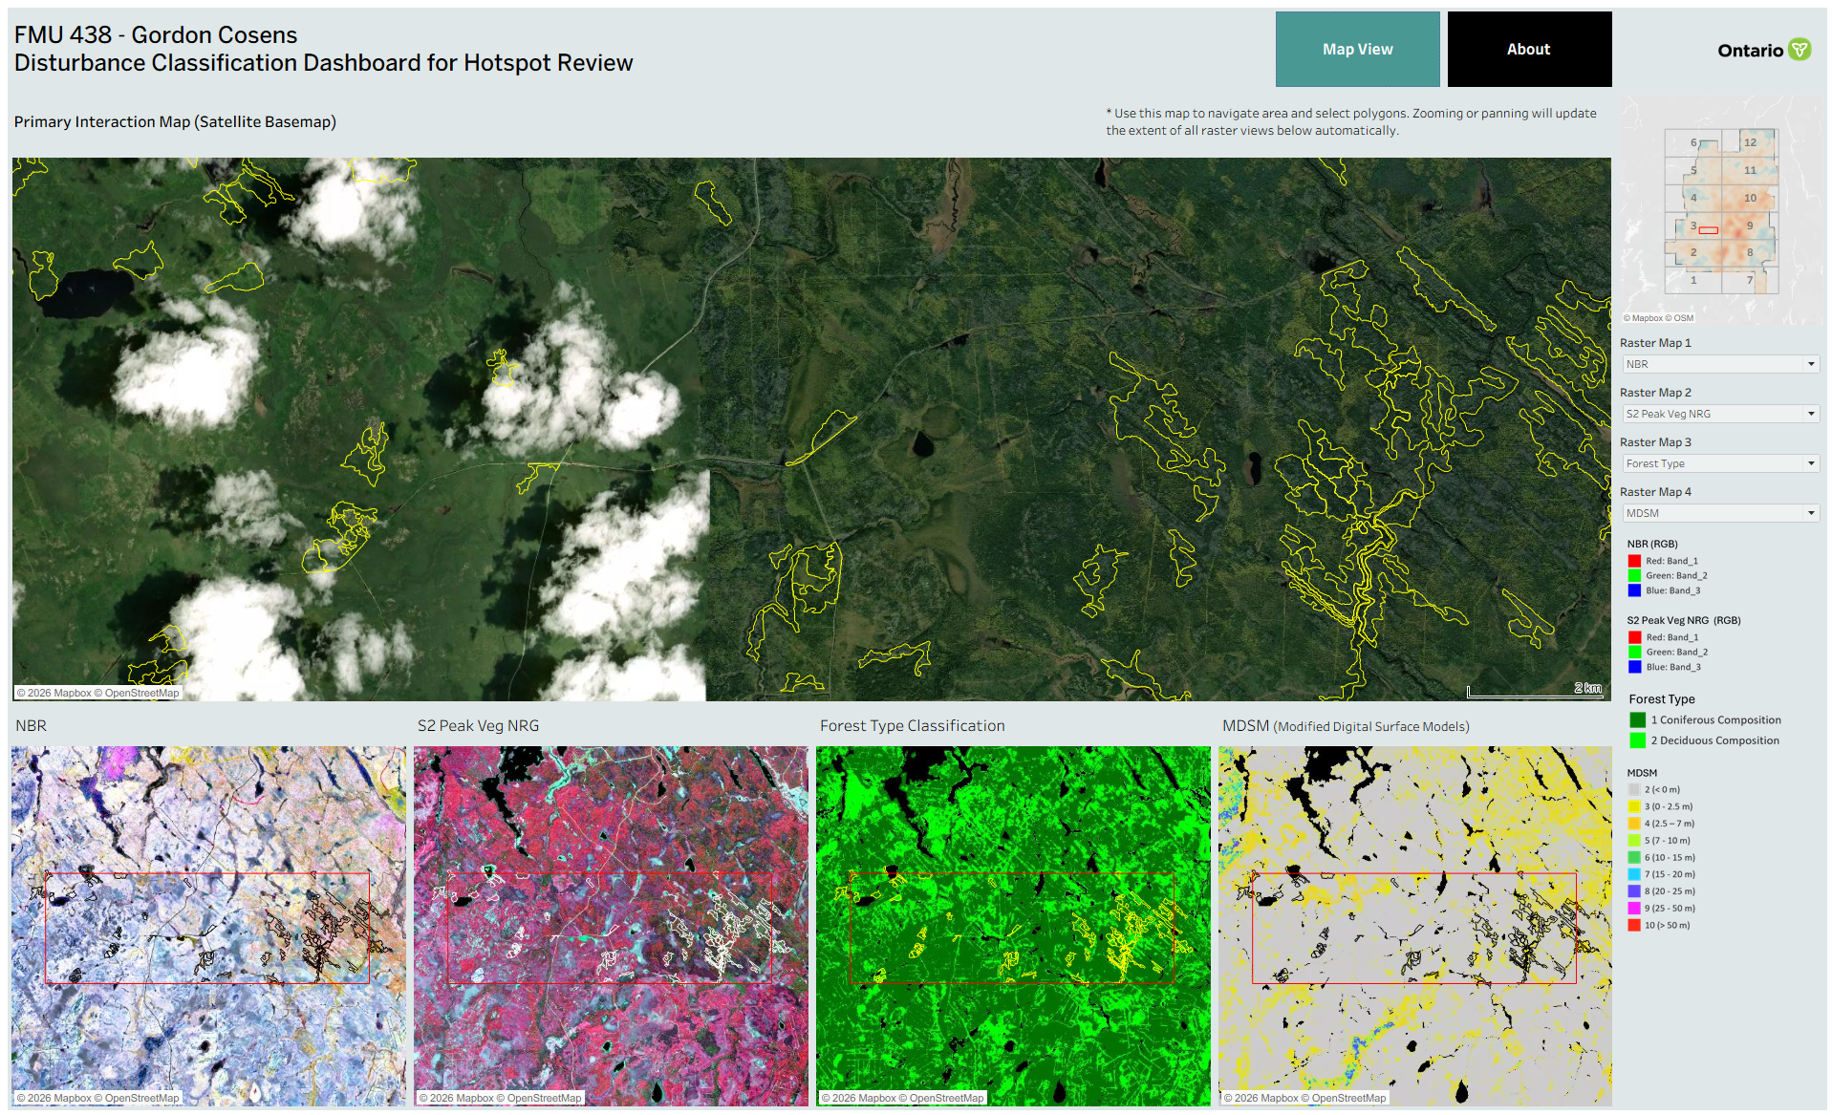
Project Overview
  Project Context and Importance
  Challenges and Opportunities
  My Role and Responsibilities
Data and Methodology
  Scalable Architecture
  Data Modeling
Analysis and Development
  Workflow Automation
  Products Version Control
  QA/QC and Data validation
Results & Collaboration
  Timeline
  Continuous Improvement
  Key Takeaways
Products Overview
1. FMU T2 Dashboard Navigator
1.1 FMU T2 Dashboard
2. FMU T2 Comparison Dashboard
3. Disturbance Dashboard
Notes:
today I will present a project focused on developing interactive LiDAR and disturbance data products for supporting Forest Resources Inventory Term 2 delivery.
The main products include the FMU T2 dashboard navigator, individual FMU T2 LiDAR dashboards, FMU comparison dashboard, and disturbance dashboard.

Slide 2
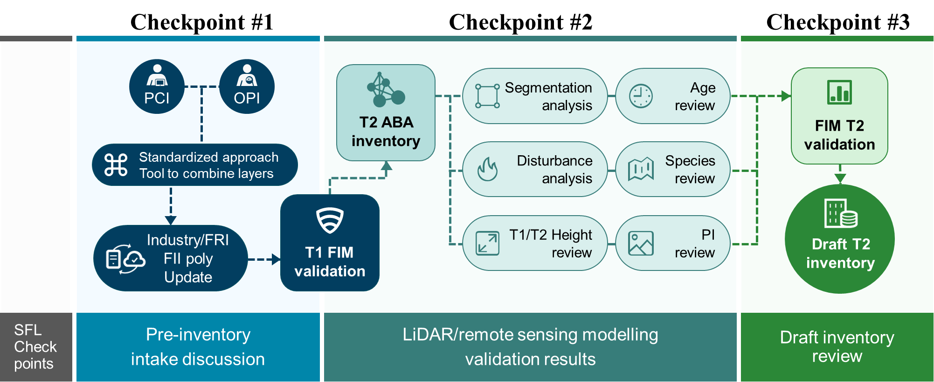
Project Overview
Project Context and Importance
FRI T2 requires better information delivery methods
Sustainable Forest Licensee (SFL) and internal users need easier access to T2 progress, LiDAR products, and disturbance results
Improved transparency, accountability and input for and by all partners
Makes complex geospatial information accessible to both technical and non-technical stakeholders
Advances FRI modernization through cloud-based data management and automation pipeline
Challenges and Opportunities
Large multi-FMU LiDAR and disturbance datasets
Frequent iterations updates while maintaining data quality and version consistency
Need for consistent dashboard outputs
Need to support both technical and non-technical users
Pic 1. Term 2 Inventory Collaborative Checkpoint Process
Notes:
The situation behind this project is that the FRI Term 2 process requires a better way to deliver information to stakeholders, especially Sustainable Forest Licence holders and internal users.
So the project focuses on transforming remote sensing and geospatial data into self-service tools for inventory validation, stakeholder communication, and data-driven decision making.
And it aims to improve transparency, support validation, and contribute to a more modern FRI delivery process.
The main challenges included large multiple FMU datasets, frequent data iterations, the need to maintain data quality and version consistency, and the need to provide consistent outputs across multiple FMUs.

Slide 3





Project Overview
My Role and Responsibilities
Product developer
Framework Design
Collaboration
Support Stakeholder
Ongoing Improvement
Primary developer for FRI T2 dashboard series
Worked with Senior Scientists to validate LiDAR metrics and spatial patterns.
Designed a scalable framework to support multiple Forest Management Units by integrating:
  LiDAR-derived data
  Raster data
  inventory status information
Collaborated with the Land Resources Cluster (LRC) / Databricks team to develop an automated cloud-based workflow.
Prepared dashboard outputs and presentations to support communication with Sustainable Forest Licensees.
Responsible for ongoing dashboard maintenance, updates, version control, and iterative improvements.
Data validation and cleaning
Spatial and temporal comparison
Dashboard development and maintenance
Workflow automation in Databricks
Stakeholder communication and iterative improvement
Notes:
My role in this project was as the primary developer od the products and workflow, and I was responsible for iterative improvement.
Another important part of my role was stakeholder support and collaboration.
Overall, my work covered the full development lifecycle: data integration, visualization development, validation support, stakeholder communication, maintenance, and continuous improvement.

Slide 4






























Data and Methodology
Scalable Architecture - From Remote Sensing Inputs to FRI Data Products
1 Data Sources
2 Ingestion
3 Validation /
Spatial Analysis
5 Cloud Storage
6 Development Pipeline
7 Delivery
LiDAR-derived Inventory Polygons
Connection
Azure Blob Storage
FRI
GeoHub
FMU Boundaries and Planning Schedules
Delta Sharing
Protocol
Lakebase
Postgres
Server
Lakebase
Postgres
Delta
Table
Tableau Public
Dashboards
4 Processing / Transformation
Tableau Dashboard
Tasking Layer & Disturbance
Tableau Cloud
Data Modelling
GeoServer
Template Design
Landsat
Satellite Imagery
Web Map Services (WMS) Raster Layers
SQL / R Calculation, Parameter & Filter
PowerPoints Slide
Data Governance
Data Quality
Cloud-based Data Management
Automated Workflow & Version Control
Publishing Standards
Stakeholder Support
Notes:
This is the architecture of the product workflow.
The source data include LiDAR-derived inventory polygons, FMU planning schedules, disturbance layers, Metadata and status tables
These data are ingested through Azure Blob Storage and FRI GeoHub.
The raw data go through validation and spatial analysis, including LiDAR metric checks (like age, canopy closure, vertical structure), raster mask clip, outlier identification
Then they are processed using Databricks, Python, GDAL, PostgreSQL, and Tableau Prep.
The processed data are stored and managed through cloud-based services such as Delta Tables, Lakebase PostgreSQL, Tableau Cloud, and Web Map Services raster layers.
The final data products are developed through Tableau connecting with Delta sharing/ lakebase, using reusable templates, data modelling, parameters, filters.
These products are then delivered as Tableau public dashboards enable comparison across FMU. and provide PowerPoint Slides for internal review and SFL communication at checkpoint 3 meeting.
Across the entire workflow, data governance, quality control, version management, publishing standards, and forest management planning support are key considerations.

Slide 5


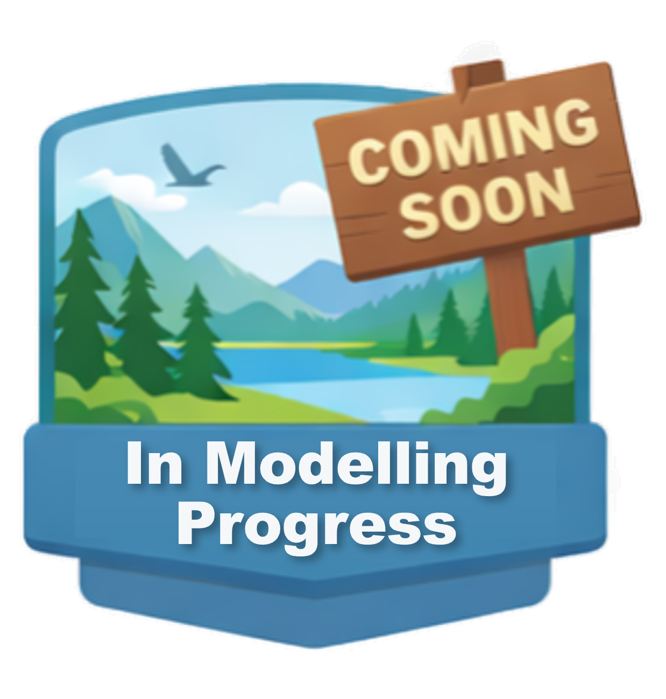
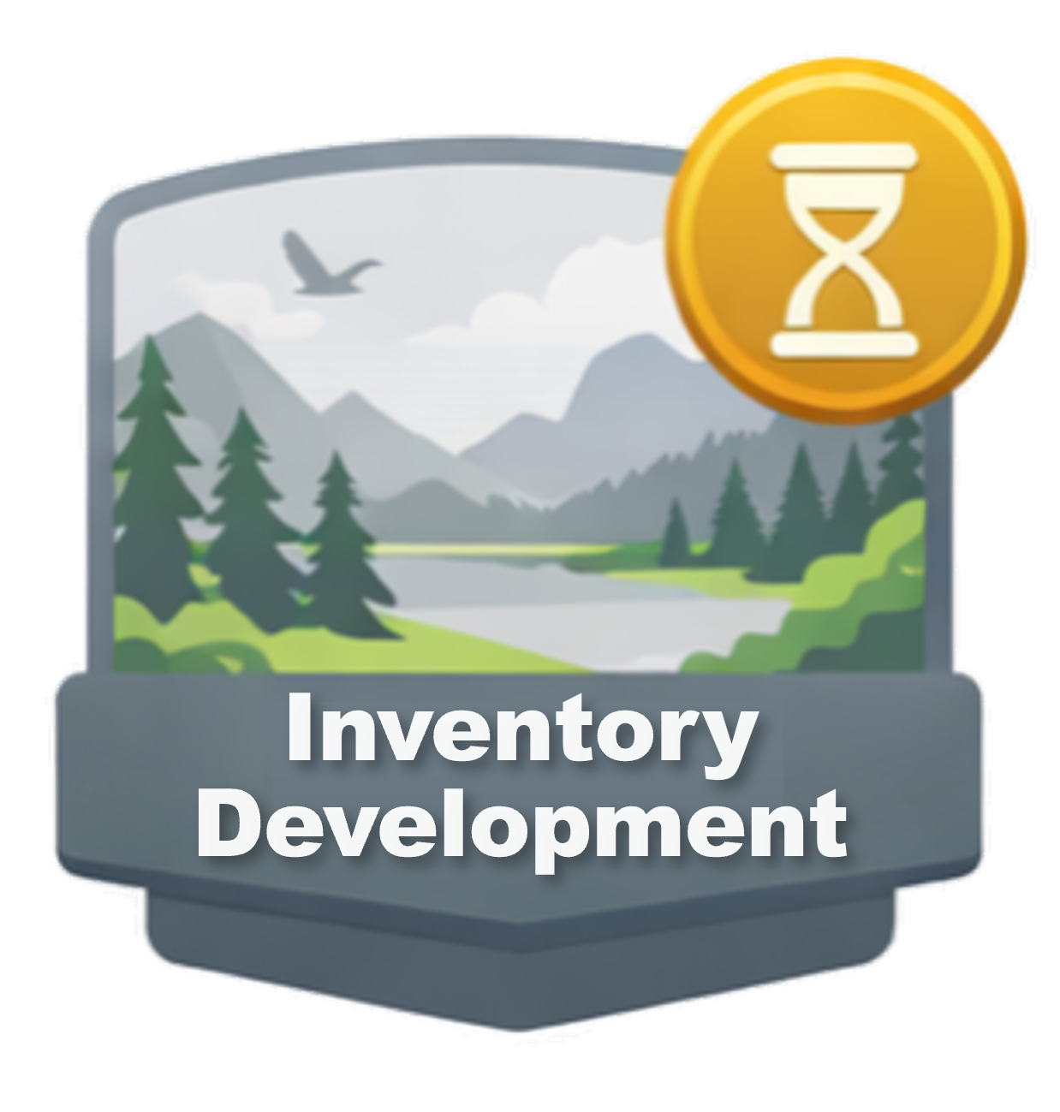
Data and Methodology
Data Modeling - MU Code connects temporal, spatial, polygon, raster, and dashboard status data into one reusable FMU-level reporting model.
Temporal Classification
• Pre T1(Prior to 2007)
• T1 (2008 - 2017)
• FII (Forest Input Inventory)
• T2 (2018 - 2028)
FMU Schedule Table
Primary Key: MU Code
FMU Boundary
• Unit boundary
• Planning schedule
• Dashboard update status
Spatial Classification
LiDAR Polygon Products
Raster Products
• Forest Region
- Boreal Forest
- Great Lakes-St. Lawrence (GLSL)
• Ownership
- All Forest
- Crown Land
• Polygon Type (POLYTYPE)
- Forest polygons (FOR)
- Species composition (OLEADSPC)
* LiDAR metrics (GMVL…)
- Age Class (OAGE)
- Site Class (SC)
• Raster - Disturbance-related layers
- Normalized Burn Ratio (NBR)
- Forest Type
- Modified Digital Surface Model (MDSM)
- Sentinel-2 Peak Vegetation
• Vector – Target Polygons
Validation and Comparison
• PreT1-to-T2 comparison
• Cross-FMU analysis
• Outlier and uncommon value checks
• Spatial quality assessment
Notes:
This is the data modeling structure behind the dashboards.
At the center is the FMU Schedule Table, and the Primary key is the MU Code. I used MU Code to connect different types of data across the dashboard framework.
On the temporal side, the model supports comparison across different inventory periods, including Pre T1, T1, FII, and T2. This allows users to compare forest inventory information across time and better understand changes in forest conditions.
On the spatial side, the model separates reporting logic by forest region and ownership type. This is important because Boreal Forest and Great Lakes–St. Lawrence Forest have different species composition and forest structure, and Crown Land reporting may differ from all-forest reporting.
For polygon products, the model connects forest polygons, species composition, age class, site class, and LiDAR metrics. For raster products, the model connects disturbance-related layers such as NBR, forest type, MDSM, Sentinel-2 peak vegetation, and target polygons.

Slide 6
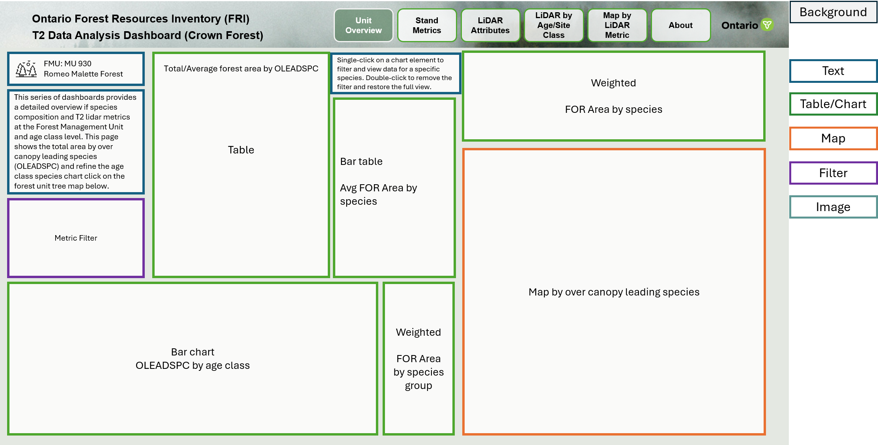
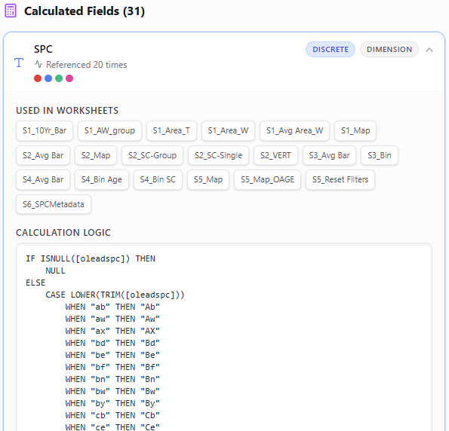
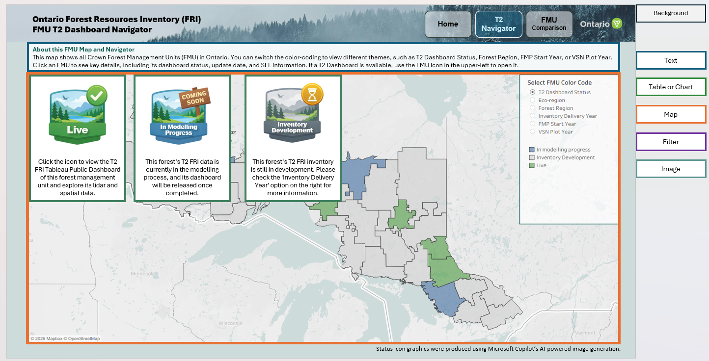
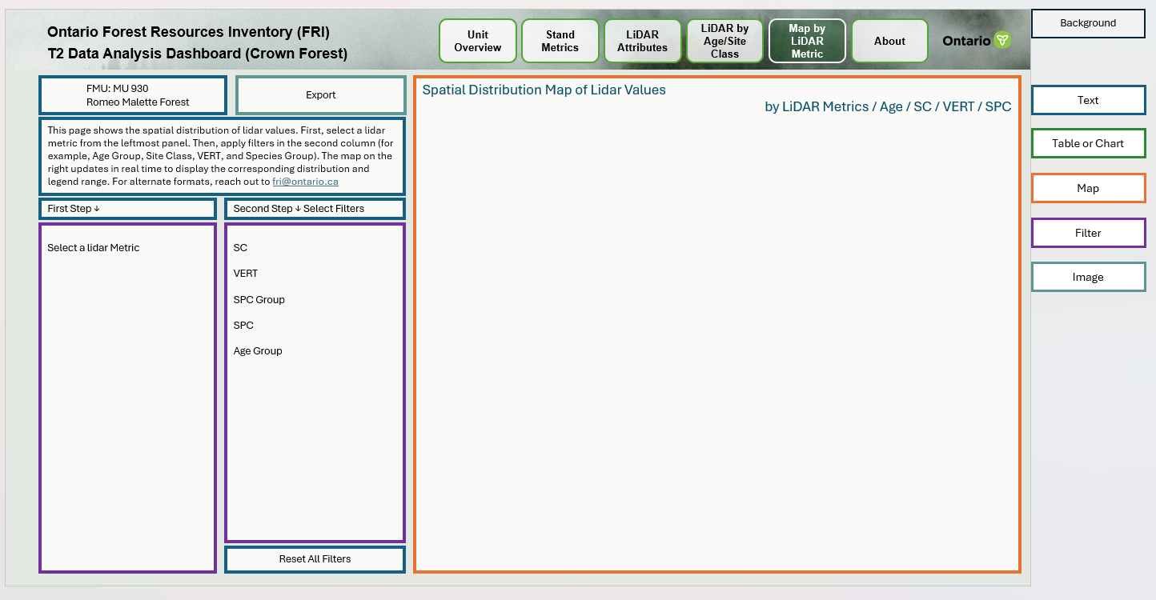
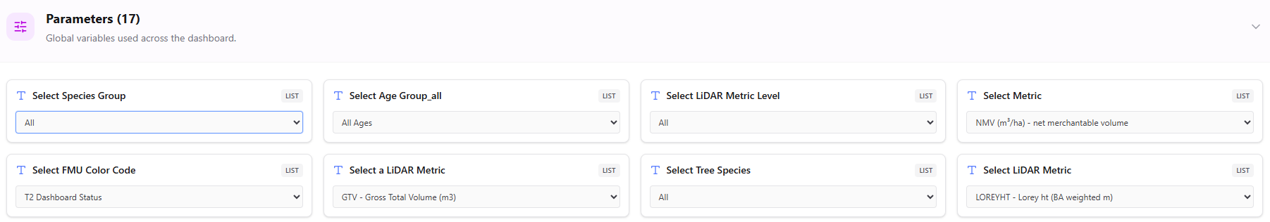
Data and Methodology
A precise T2 LiDAR dashboard to be generated for a new FMU within 30 minutes to 1 hour
Reusable Templates
Standardized Calculations
Parameterized Filters & Function
Notes:
Instead of rebuilding each dashboard from scratch, I designed reusable templates with standardized calculation fields and parameter controls, such as species group, and LiDAR metric level
These controls allow one dashboard structure to adapt to different FMUs and different reporting needs.
With this workflow and approach, once the data for a new FMU are prepared, a precise T2 LiDAR dashboard can be generated in about 30 minutes to 1 hour.

Slide 7
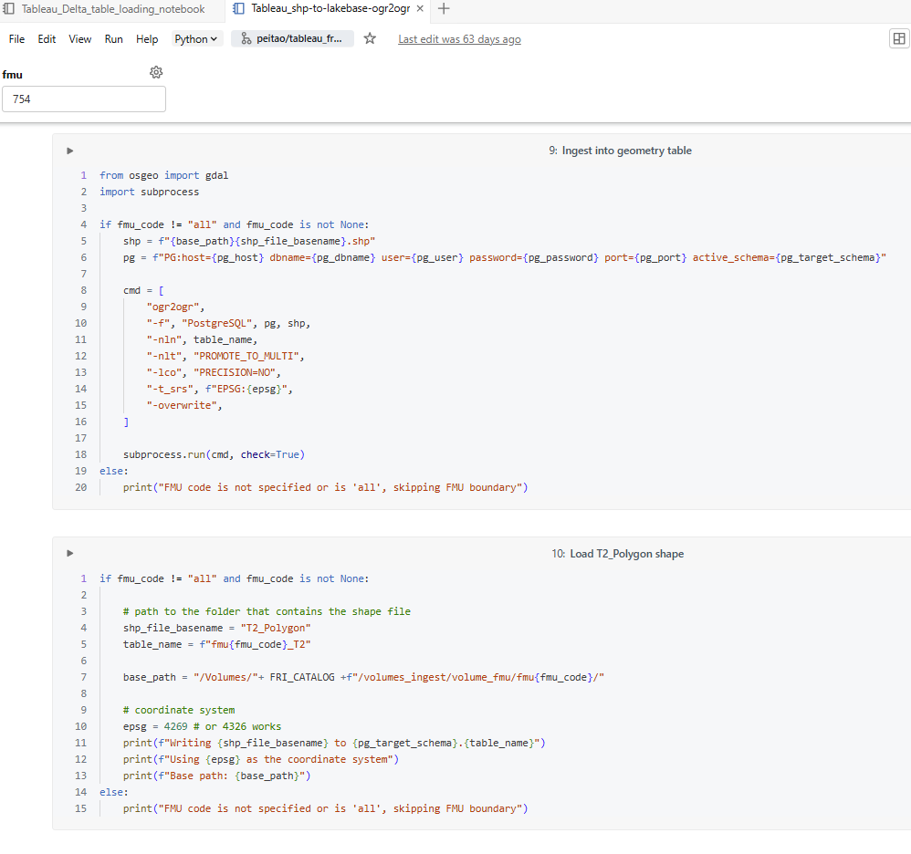
Development
Workflow Automation and Efficiency Improvement
Impact
Reduced dashboard developing time by 80%
Improved consistency & reduced manual work
Better internal collaboration through shared cloud-based data services
Repeatable framework for future FRI products
Previous Workflow:
Local file-based process
Improved Workflow:
Cloud-connected process
.
Business Problem:
Local shapefiles, Excel tables, and Tableau extracts worked for early development, but became difficult to scale across many Forest Management Units.
Key limitations:
Large file sizes and slow Tableau extracts
Version control challenges across dashboard iterations
Limited collaboration due to local file paths
Less scalable for future Live use
Solution:
Shifted data preparation and calculations toward Databricks, Lakebase PostgreSQL, and reusable dashboard templates.
Key improvements:
Centralized and cloud-based data services instead of local files
Reusable templates for FMU dashboards
Automated refresh/update logic
Better support for multi-FMU and future product delivery
Notes:
The previous workflow relied on local files, it’s hard to handle large size files, and limited collaboration through local file paths.
The improved workflow shifts data preparation and calculations toward Databricks and reusable templates. This makes the process more centralized, repeatable, and easier to maintain.
The impact is significant. Dashboard development time was reduced by about 80 percent. The workflow also improved consistency, strengthened internal collaboration through shared cloud-based data services

Slide 8



Interactive LiDAR & Disturbance Data Products for FRI T2 Delivery
Supporting Forest Resources Inventory (FRI) Term 2 (T2) Delivery, and transforming remote sensing and geospatial data into self-service tools for inventory validation, stakeholder communication, and data-driven decision making and reporting.
Development
Products Version Control
Tableau Dashboard
Draft version 1.0
Used for internal review to identify uncommon values or potential issues in the Term 2 inventory data
Draft version 1.x
Few iterations between V1.0 and V2.0
Draft version 2.0
Shared with SFLs to review all LiDAR metrics, and disturbance analysis results with spatial context to help stakeholders understand the disturbance patterns, and compare outcomes across the forest unit.
Final version
Used to deliver the finalized FRI Term 2 data for Checkpoint 2/3 to support SFL’s review and validation, reducing back-and-forth during planning and review.
* All versions – accessible only by direct link
Notes:
For version control of the product.
Version 1.0 is mainly used for internal review and early data quality concerns. After few iterations, Version 2.0 is shared with industry partners to review LiDAR metrics, and spatial patterns in a more interactive way.
The final version supports delivery of the finalized data products, helping reduce back-and-forth communication during planning and validation.

Slide 9
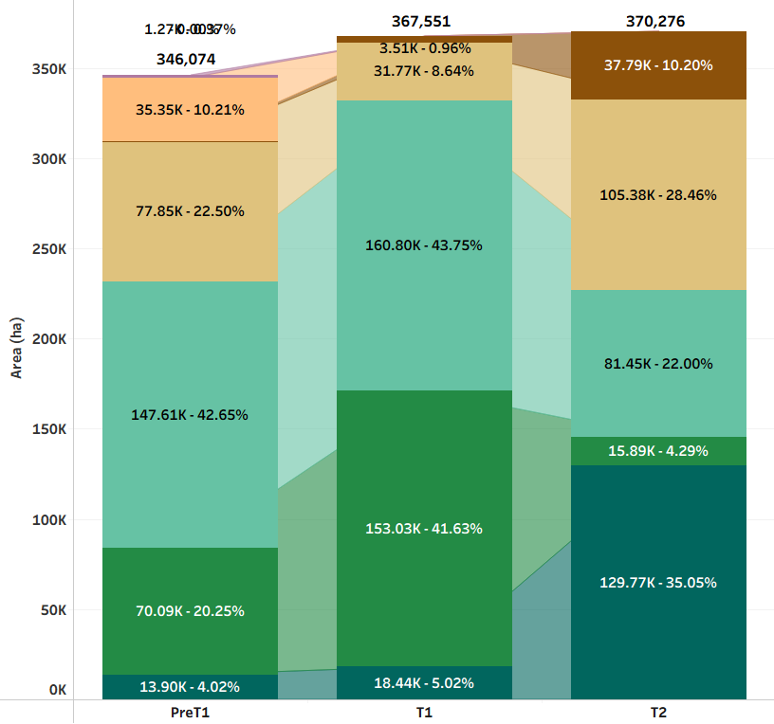
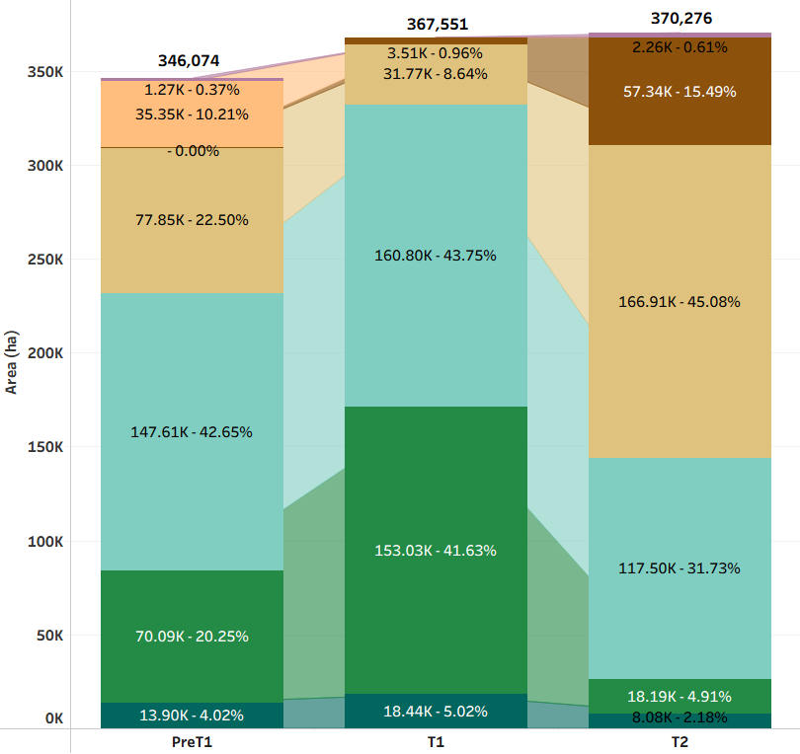
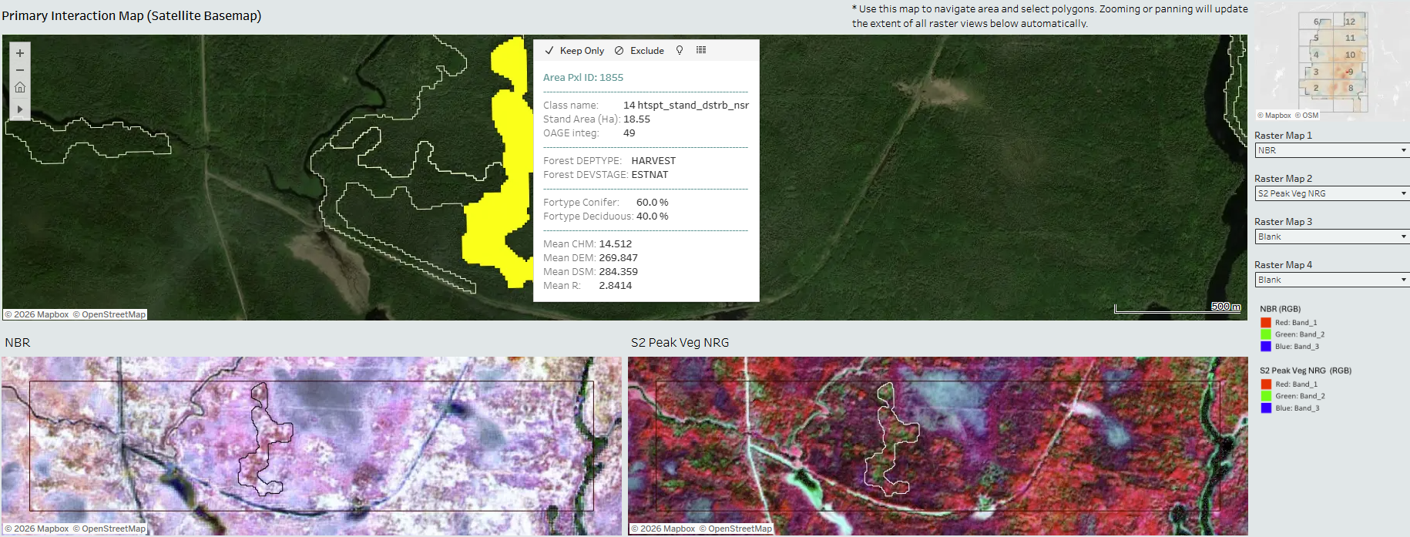
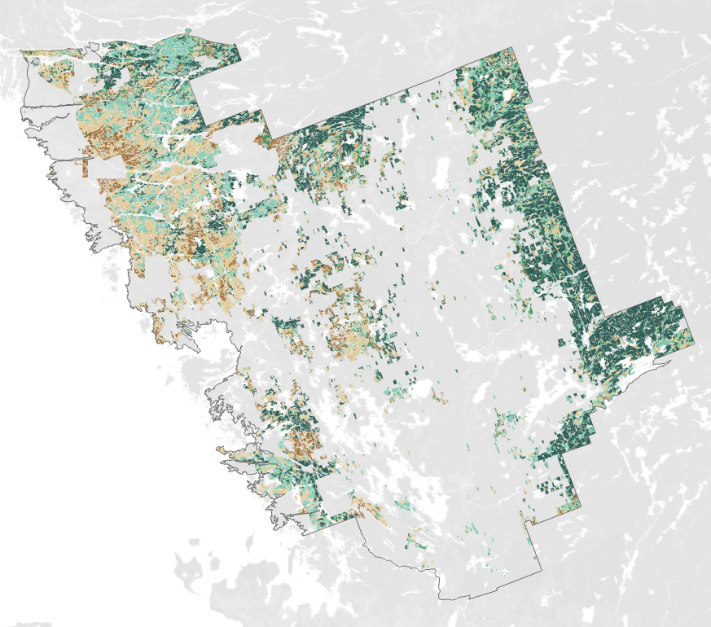
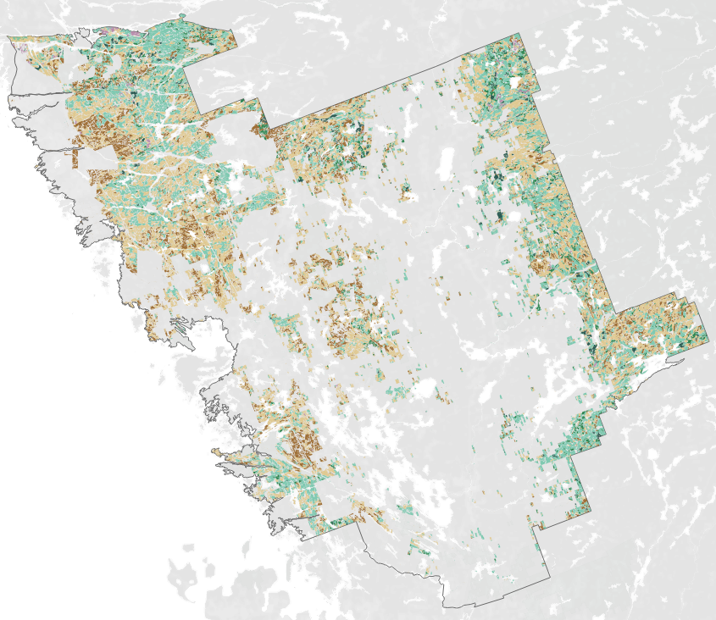
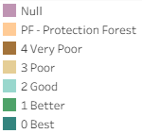
Interactive LiDAR & Disturbance Data Products for FRI T2 Delivery
Supporting Forest Resources Inventory (FRI) Term 2 (T2) Delivery, and transforming remote sensing and geospatial data into self-service tools for inventory validation, stakeholder communication, and data-driven decision making and reporting.
Development
QA/QC and Data validation
Supports quality checks and validation
Identified trends, outliers, uncommon values
Reviewed LiDAR metrics within one FMU, across FMUs, and across inventory periods
Supports visual review of disturbance outputs and hotspot polygons
FMU 438 Gordon Cosens visual review with target polygon
FMU 360 French Severn Outlier of Site Class 0 and after Adjustment
Notes:
The products support review at multiple levels: within one Unit, across multiple Units, and across inventory periods.
For example, the picture on right side shows that it identified the polygon area of site class 0 on T2 period is too high in Frence Severn, and help make the adjustment.
For disturbance products, the dashboard supports visual review of disturbance outputs and targeted polygons

Slide 10
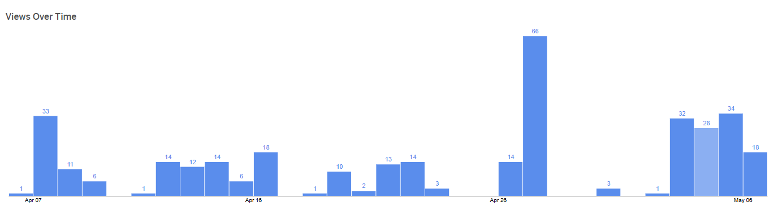
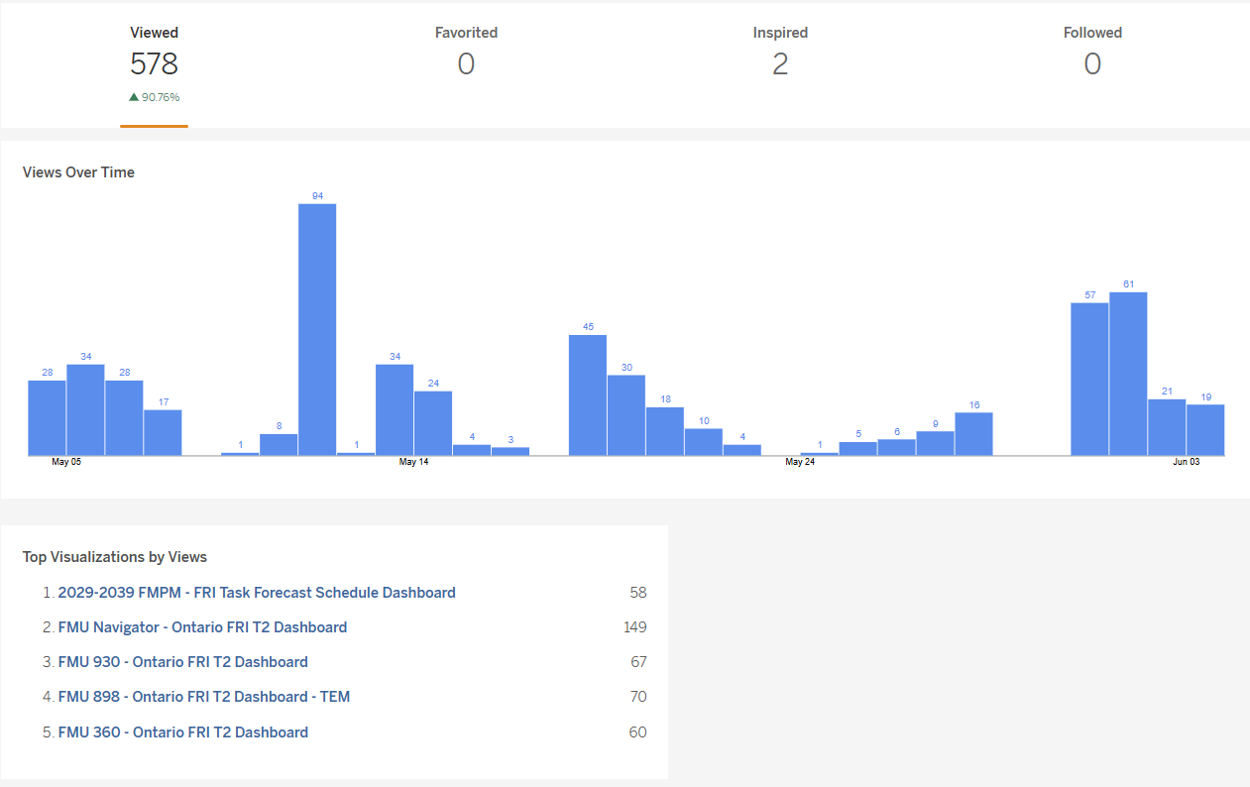
Interactive LiDAR & Disturbance Data Products for FRI T2 Delivery
Supporting Forest Resources Inventory (FRI) Term 2 (T2) Delivery, and transforming remote sensing and geospatial data into self-service tools for inventory validation, stakeholder communication, and data-driven decision making and reporting.
Results & Collaboration
Project Timeline
2026.6
Databricks workflow finalized and transitioned to production environment (Prd)
2025.12
CP3 MU60 - feedback from SFL and Ministry users (Policy)
2026.2 – 2026.4
Databricks workflow (demo) development and ingestion connection testing (Ist.env)
2026.4
MU438 Gordon Cosens Disturbance Dashboard (demo)
2026.5 - 6
MU360 French Serven Forest Dashboard Published
2025.10 - 11
Initial Demo - MU60
White River Forest
2025.12 - 2026.1
Data modelling adjustment & MU60 Dashboard Published
2026.3
MU930 Romeo Malette Forest Dashboard Published
2026.5
MU754 Nipissing Forest Published
MU898 Temagami Forest Published
FRI T2 Data Products by the numbers
8
2
2
T2 LiDAR Dashboard Published
T2 LiDAR Dashboards Planned
New Data Products in Development
Viewed
Tableau Public dashboards viewed by users between March and June 2026.
2,722
Notes:
The timeline shows how the project moved from the initial demo in late 2025, through Checkpoint 3 feedback, data model adjustment, and Databricks workflow improvement.
By now, seven T2 LiDAR dashboards had been published, some additional dashboards were planned or in development following the FMP
All dashboards were viewed more than 17 hundred times in this 4 months, which shows that the products are being actively used by stakeholders and internal users.

Slide 11
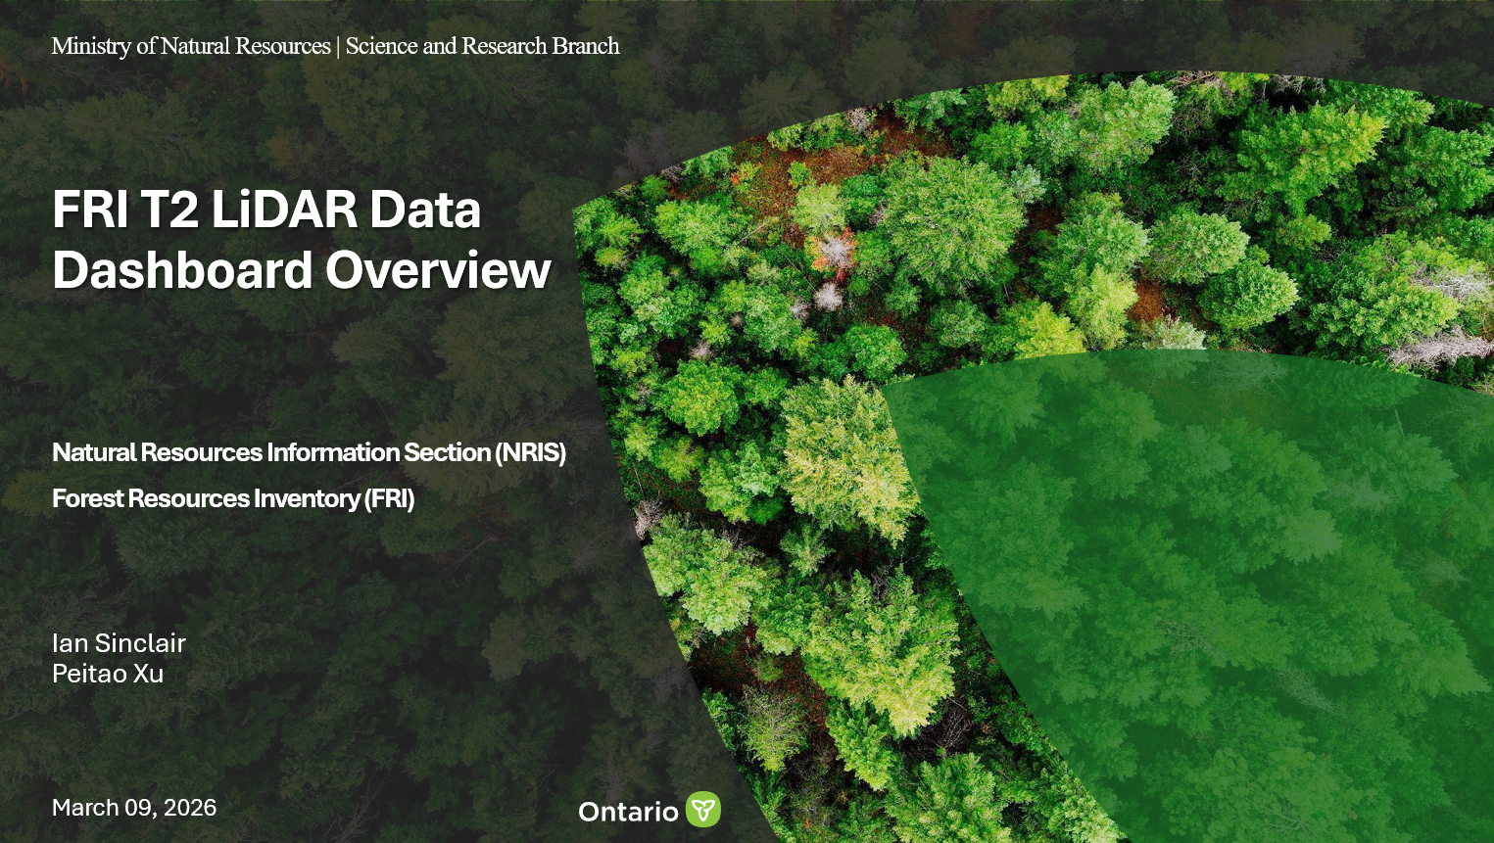
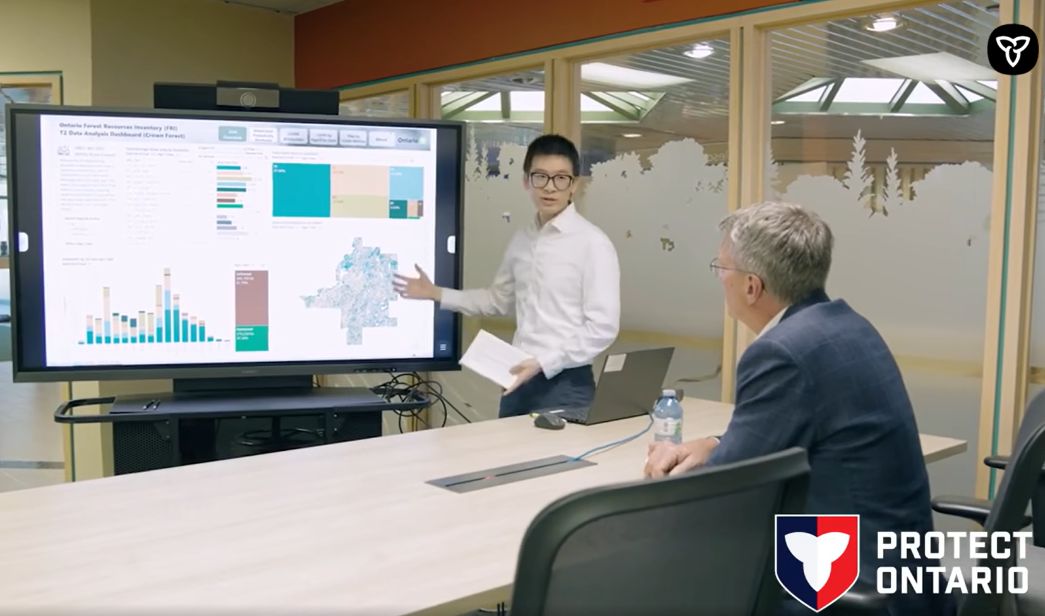
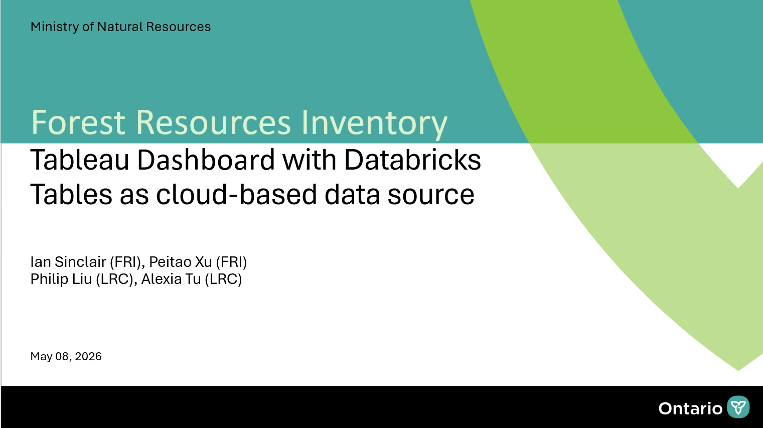
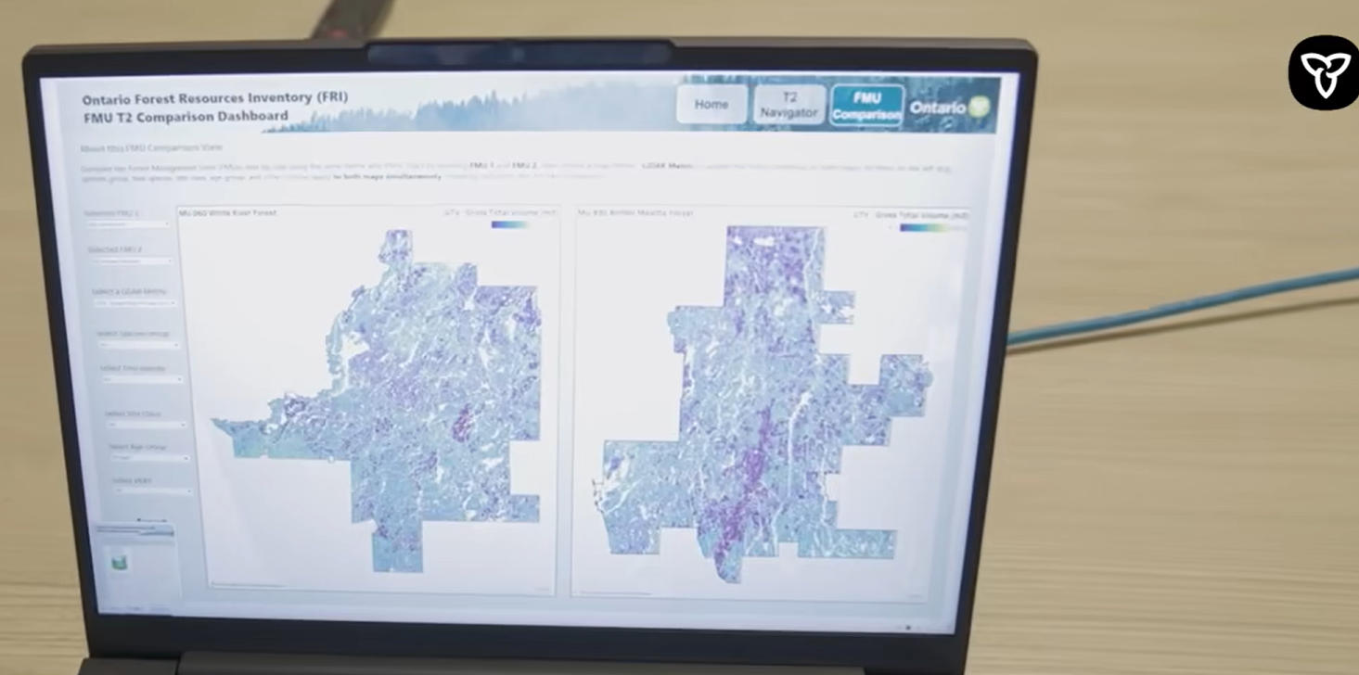
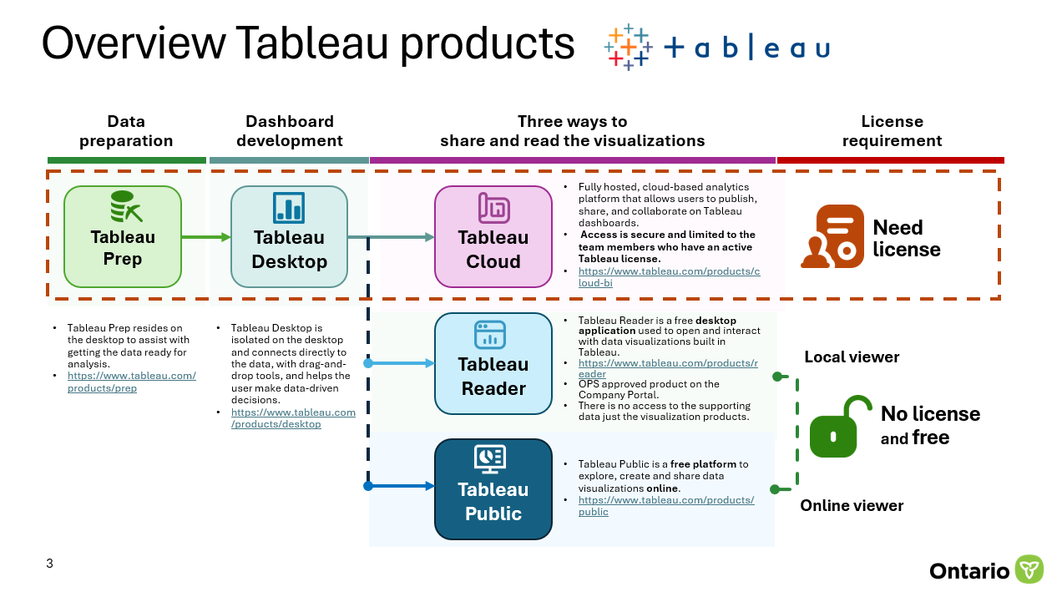
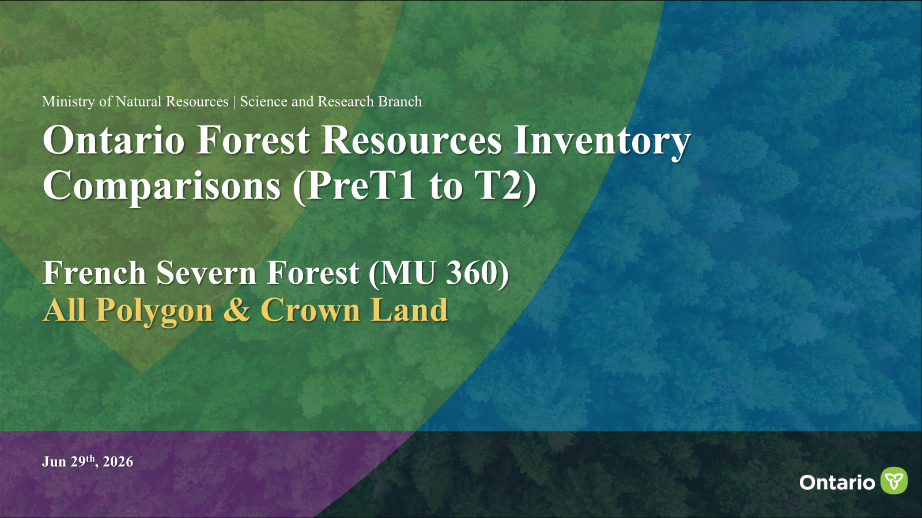
Interactive LiDAR & Disturbance Data Products for FRI T2 Delivery
Supporting Forest Resources Inventory (FRI) Term 2 (T2) Delivery, and transforming remote sensing and geospatial data into self-service tools for inventory validation, stakeholder communication, and data-driven decision making and reporting.
Results & Collaboration
Internal collaboration
MNR Associate Minister (AMO) Visiting
Overview slides for introduction
Collaborate with Senior Analyst and Scientist to create overview materials to align FRI staff on dashboard goals, data product content, and review requirements
Collaborated with FRI team to introduce interactive FRI T2 dashboard products. Presented FRI T2 context, delivery overview, LiDAR metric maps, and FMU comparison outputs.
Supported communication of FRI modernization and digital data delivery aligned with Ontario’s investment in forest sector competitiveness.
Collaborated with LRC colleagues
Worked with Land Resources Cluster colleagues on Databricks workflow development and technical recommendations
Advising Tableau Public to Managers
Work with Assessment & Reporting Specialist to outline the security and control of Tableau Public as a communication and delivery tool
FMU Comparison slides
Collaborate with Senior Analyst to create Comparison materials to support SFL review for checkpoint 3
Notes:
Internally, I created overview slides and materials to help FRI staff understand the structure, and content of the T2 data products.
I also collaborated with LRC colleagues on Databricks workflow development and technical recommendations.
In addition, I worked with Assessment Specialists to outline the security and control of Tableau Public as a communication and delivery tool to FRI management team.
A key communication opportunity was introducing the products during the MNR Associate Minister visit. I collaborated with the FRI team to present the products, and LiDAR metrics.
This also aligns with Ontario’s broader investment in modern digital forest inventory tools.

Slide 12
Interactive LiDAR & Disturbance Data Products for FRI T2 Delivery
Supporting Forest Resources Inventory (FRI) Term 2 (T2) Delivery, and transforming remote sensing and geospatial data into self-service tools for inventory validation, stakeholder communication, and data-driven decision making and reporting.
Results & Collaboration
Continuous Improvement
Lessons Learned
Workflow Modernization
Expand Lakebase and spatial SQL for advanced geospatial processing.
Remote sensing products must be delivered in a way stakeholders can understand
QAQC / Validation
Continue improving validation through Databricks dashboards and AI agent quality checks.
Automation and cloud technologies improve scalability.
Automation
Explore scheduled refresh options for future T3 delivery
A successful product depends on both technical architecture and user-centered design.
Future Products
Apply lessons learned to future LiDAR and disturbance products.
Web Map Services
Evaluate WMS publishing options through approved geospatial platforms for Raster data.
Early stakeholder engagement improves adoption.
Notes:
Future improvements include expanding the use of Lakebase and spatial SQL for workflow modernization, automation for T3 develivery, and so on.
Key lessons learned are 1. remote sensing products need to be delivered in a format that stakeholders can understand and use. 2. A technically strong product is not enough if users cannot interpret the information.
3. automation and cloud workflows improve scalability, but successful data products also depend on strong technical architecture, user-centered design, and early stakeholder engagement.

Slide 13
Interactive LiDAR & Disturbance Data Products for FRI T2 Delivery
Supporting Forest Resources Inventory (FRI) Term 2 (T2) Delivery, and transforming remote sensing and geospatial data into self-service tools for inventory validation, stakeholder communication, and data-driven decision making and reporting.
Results & Collaboration
My Key Contributions
DELIVER
SCALE
SUPPORT
Turning LiDAR and remote sensing outputs into FRI data products
Using cloud workflows to support multi-FMU delivery
Enabling validation, communication, and stakeholder review
Developed interactive FRI Term 2 LiDAR and disturbance data products.
Integrated LiDAR metrics, satellite disturbance products, FMU boundaries, polygon data, raster layers, and inventory status information.
Produced tools that support inventory validation, spatial review, and decision making.
Built a scalable workflow using Python, SQL, Databricks, PostgreSQL / Lakebase, Azure, WMS, and Tableau.
Designed reusable templates, parameterized filters, and standardized calculations.
Reduced manual setup and supported faster deployment across Forest Management Units.
Supported Sustainable Forest Licence holders and internal teams through dashboards, maps, charts, and presentation materials.
Worked with FRI staff, Senior Scientists, LRC / Databricks team, and reporting specialists.
Helped translate complex remote sensing information into clear decision-support products.
Remote Sensing & Geospatial Expertise
Analytical & Problem-Solving Skill
Project Coordination & Continuous Improvement
Communication & Stakeholder Support
Notes:
In summary, This is my key contributions.
First, I delivered FRI T2 data products by transforming LiDAR and remote sensing outputs into practical tools.
Second, I built a scalable cloud-based workflow to support multiple FMU delivery.
Third, I support stakeholders and internal teams by make complex LiDAR and disturbance information easier to validate and review.
Overall, this project demonstrates the four key areas required for the role.

